Slide 1
Traffic Light System
Using Arduino
Team 05
Presented by
Wajeeh Ud Din
1240309
1

Slide 2
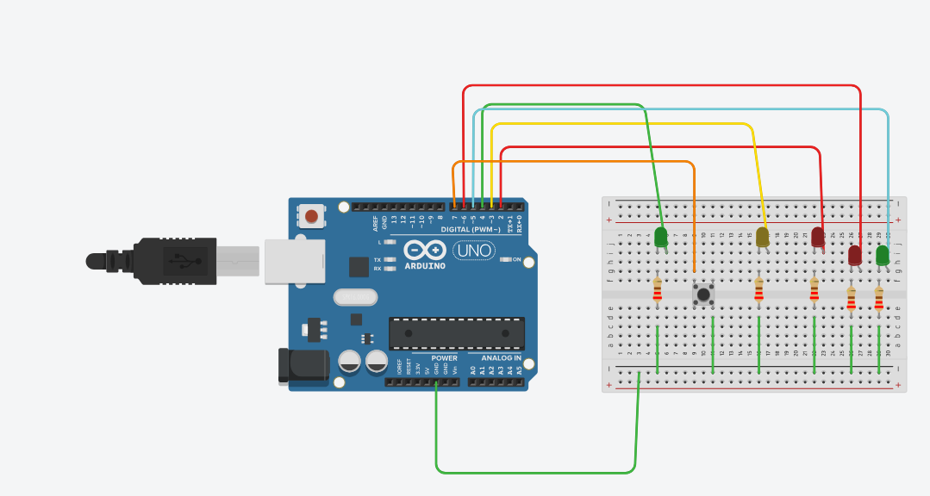
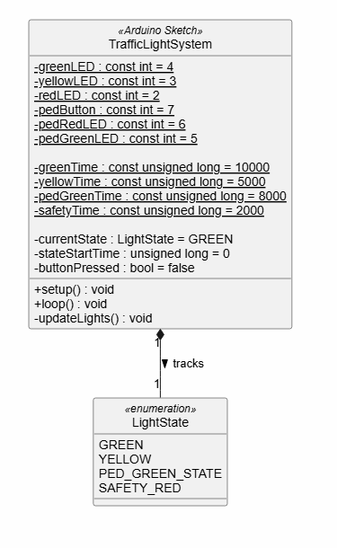
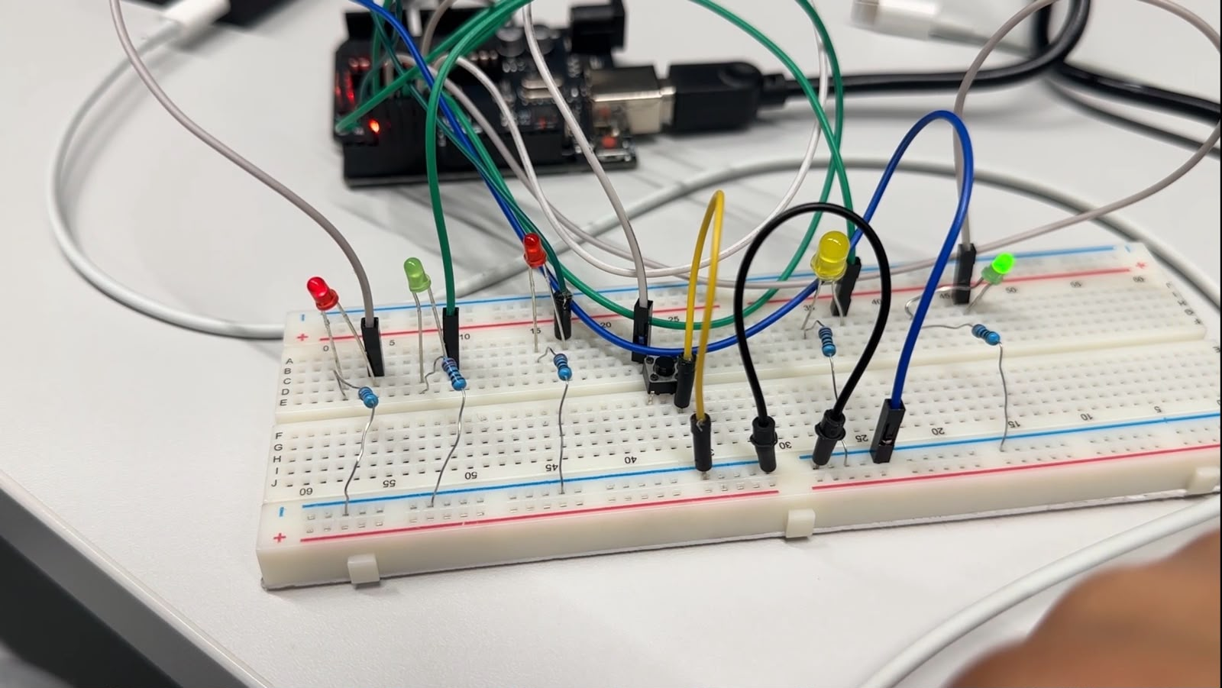
What was the task?
The main goal of this project was to design, test, and build a traffic light system using an Arduino across four steps. First, we planned a basic traffic light using diagrams, wrote the code, and tested the LED circuit in an online simulator. Second, we added a pedestrian light and a push-button, making sure the timing was safe so cars and pedestrians never have a green light at the same time. Finally, we built both versions on real Arduino hardware in the lab, tested different ways to read the button press (polling and interrupts), and saved all our files neatly in Git.
2

Slide 3
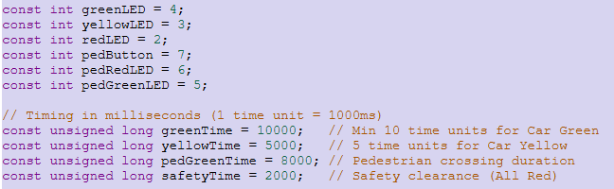
Explaining the code
Hardware Pins & Timers (Setup Variables)
This part of the code tells the Arduino which physical wire connects to which Led and how long should each Led last under different circumstances
For instance:
const int greenLED = 4;
This part gives human friendly names to pins numbered on the arduino
const unsigned long greenTime = 10000;
This sets duration for each light phase with time duration in milliseconds the
Unsigned long is a large number type used for storing time values without running out to storage
3

Slide 4
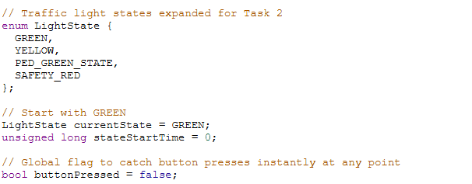
Explaining the code
States & Memory (Tracking What is Happening)
Instead of guessing what the lights are doing i used the state machine in the program to track the phase the program is going through while running the code
enum LightState {GREEN,YELLOW,PED_GREEN_STATE, SAFETY_RED};
Is an approach to make 4 possible situations at a real intersection.
LightState currentState = GREEN;
Is used as an active phase variable which indicates that the green Led is ON when the arduino is powered ON
unsigned long stateStartTime = 0;
This acts as a stopwatch and records exactly when a new light phase began
bool buttonPressed = false;
This is a t/f memory flag and helps remember if the pedestrian hit the ped-light button until the minimum time for the vehicle green is reached
4

Slide 5
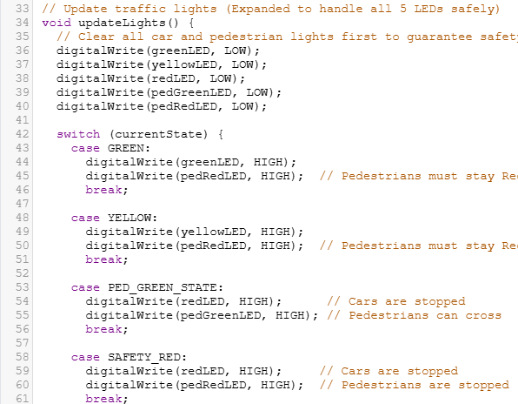
Explaining the code
The updateLights() Function (Controlling the LEDs)
void updateLights()
Defines reusable block of code which performs actions but does not send back any calculated number
Lines 36-40 helps turning all Leds completely Off before turning the right ones ON to prevent any conflicting Leds to be turned ON at the same time
switch (currentState)
Checks value inside the and then uses the appropriate case
5

Slide 6
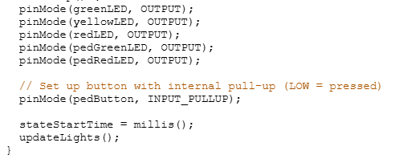
Explaining the code
The setup() Function (Runs Once at Power-On)
pinMode(greenLED, OUTPUT)
Configures all 5 LED pins as OUTPUT so the Arduino can push electricity out to light them up.
pinMode(pedButton, INPUT_PULLUP);
Configures pin 7 as an INPUT to read the button. INPUT_PULLUP activates a built-in resistor that keeps the pin reading HIGH normally, and drops to LOW when pressed.
stateStartTime = millis();
Checks the Arduino's internal clock which counts milliseconds since powerd on and saves the starting time.
updateLights();
Calls the light function immediately so the green car light and red pedestrian light turn on right away.
6

Slide 7
Explaining the code
The loop() Function (Runs Forever)
The loop() function runs continuously to monitor the pedestrian button and track how much time has passed in the current traffic light phase. Whenever a button press is detected, it saves that request in memory so it is not missed. At the same time, it compares the elapsed time against the active phase's timer, advancing the system through the sequence—from green to yellow, pedestrian green, safety red, and back to green—once the required time and button conditions are met. Whenever the state changes, it resets the timer and updates the physical LEDs to match the new phase.
7

Slide 8
8

Slide 9
Thank you
Wajeeh Ud Din Shuja
Email: wajeeh-ud-din.shuja@stud.hshl.de
1240309
9

